Slide 1
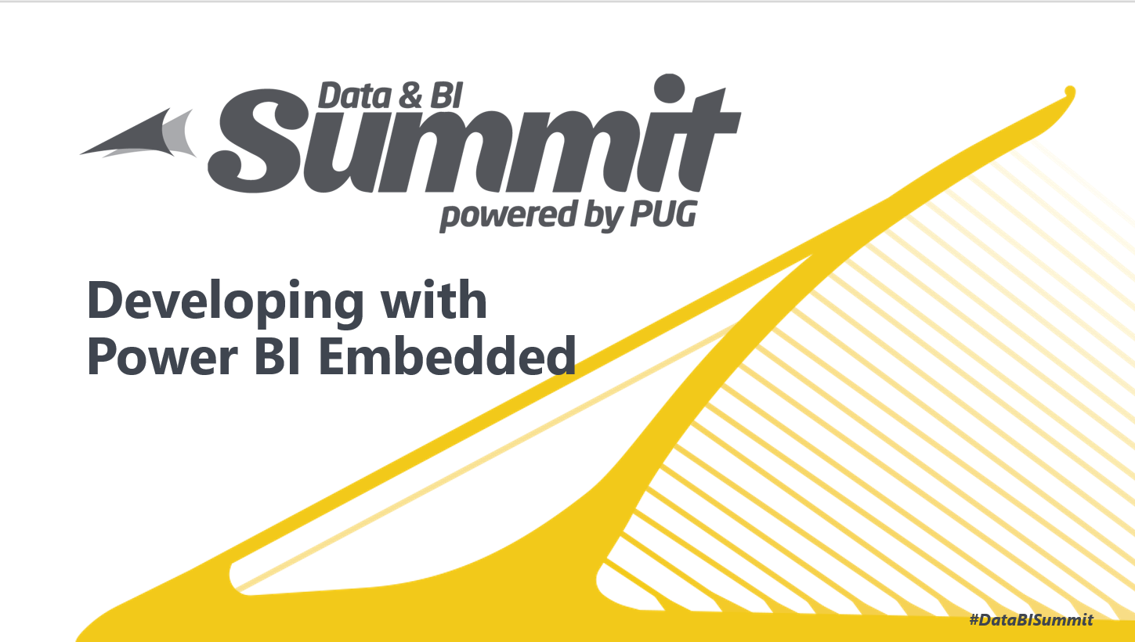

Slide 2
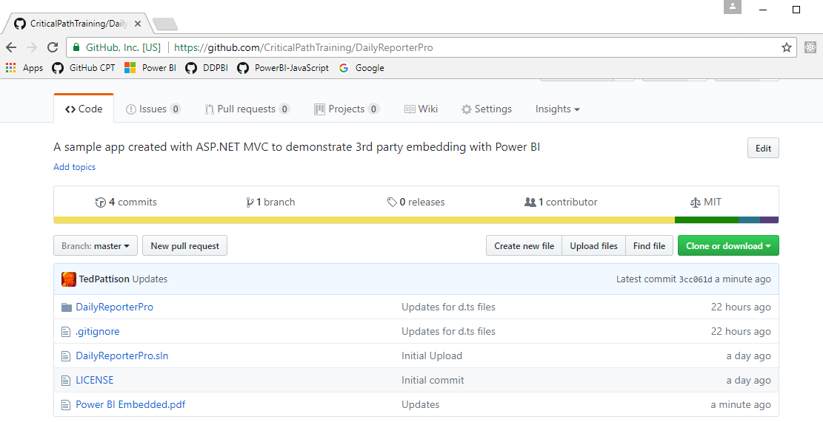
Code and Slides for this Session
https://github.com/CriticalPathTraining/PowerBiEmbedded

Slide 3
Agenda
Power BI Embedding Fundamentals
App Workspaces and Dedicated Capacities
Authentication with Azure Active Directory
Programming with Power BI Service API
Working with Embeddable Resources
Embedding with Power BI JavaScript API

Slide 4
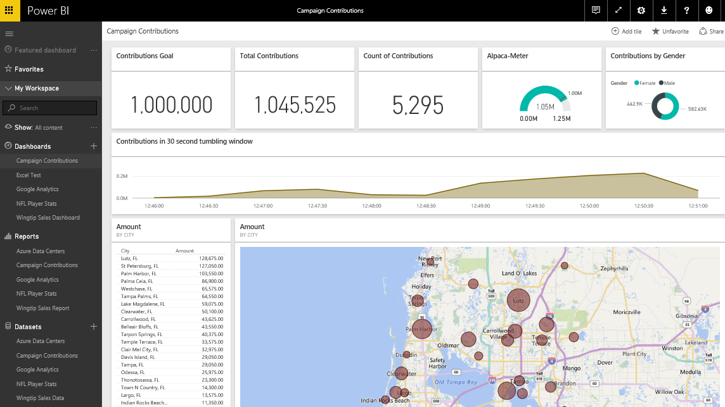
The Power BI Service
Provides cloud-based foundation for Power BI platform
Accessible with browser through https://app.powerbi.com
Accessible through Power BI mobile apps
Accessible to developers through Power BI Service API
Notes:
You can think of the Power BI service as the heart and sole of the Power BI platform. Subscribed users access the Power BI service using any modern browser through its primary URL which is https://app.powerbi.com. Once a user has been authenticated against the common endpoint of https://app.powerbi.com, the users is then connected to the Azure data center which hosts the user’s Power BI workspaces.
Using the browser, a Power BI subscriber can view dashboard and interactive reports. The browser-based experience of the Power BI service also provides support to import datasets and to create reports and dashboards.

Slide 5
The Power BI Service API
The Power BI Service API goes by other names
The Power BI REST API
The Power BI API
Using the Power BI Service API
Accessible by making direct REST calls against service
Accessible by using Assembly DLL that abstracts away REST calls
Assembly DLL is named Microsoft.PowerBI.Api.dll
Assembly DLL part of NuGet package (Microsoft.PowerBI.Api)
Calling service requires authentication with Azure Active Directory
Your App
Power BI Service

Slide 6
Power BI Embedding – The Big Picture
User launches your app using a browser
App authenticates with Azure Active Directory and obtains access token
App uses access token to call to Power BI Service API
App retrieves data for embedded resource and passes it to browser.
Client-side code uses Power BI JavaScript API to create embedded resource
Embedded resource session created between browser and Power BI service
5
Power BI Service
User
iFrame
6
4
4
3
1
Your App
2
Azure AD

Slide 7
First Party Embedding
App authenticates current user with Azure AD
Your code accesses Power BI Service as current user
Embedding requires Azure AD access token for user
User requires Azure AD account and Power BI license
Your code has access to whatever user has access to
Embed URL for Power BI resource
Access Token for current user
User
Power BI Service
iFrame

Slide 8
Third Party Embedding
App authenticates using Master User Account
Your code accesses Power BI Service as master user
Embedding uses embed token instead of access token
Users don’t need AAD accounts and Power BI licenses
Your code has access to whatever master has access to
Embed URL for Power BI resource
Embed Token created with master user account
User
Power BI Service
iFrame

Slide 9
First Party vs Third Party Embedding
What scenarios use first party embedding?
Organizations where users have Power BI licenses
Embedding Power BI reports in SharePoint and Teams
Development should go beyond out-of-box experience
What scenarios use third party embedding?
Scenarios where users don’t have Power BI licenses
Applications which have custom identity providers
Applications which use identity provider other than AAD

Slide 10
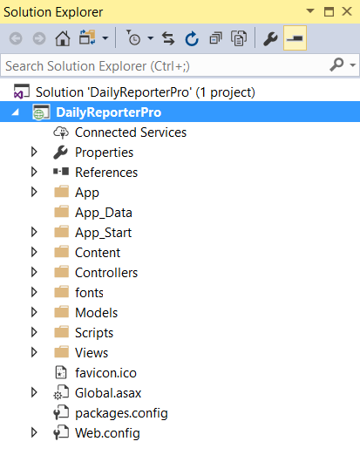
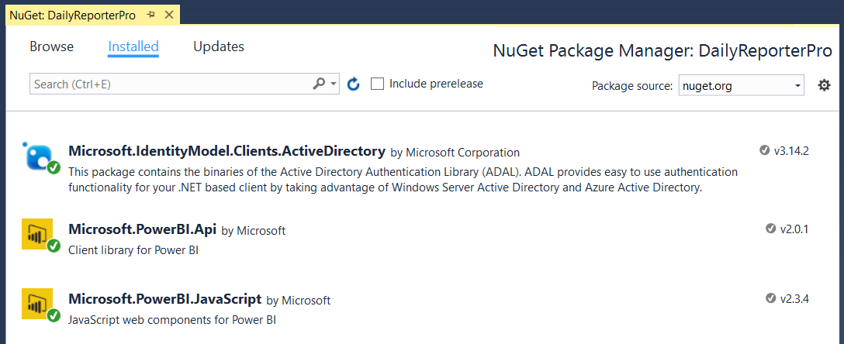
NuGet Packages Required in MVC Project
NuGet Packages used in DailyReporterPro sample app
Azure Active Directory Library (ADAL) for .NET
Power BI Service API
Power BI JavaScript API

Slide 11
The Daily Reporter Pro Sample App

Slide 12
Agenda
Power BI Embedding Fundamentals
App Workspaces and Dedicated Capacities
Authentication with Azure Active Directory
Programming with Power BI Service API
Working with Embeddable Resources
Embedding with Power BI JavaScript API

Slide 13
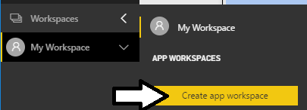
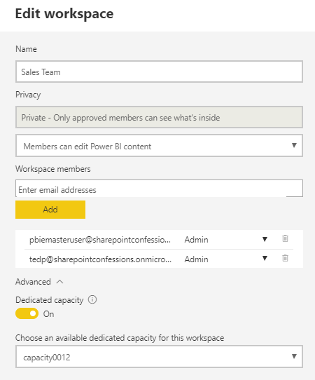
Understanding App Workspaces
App workspaces required for 3rd party embedding
You access working under identity of master user account
Master user account must be configured as app workspace admin
App workspace must be associated with dedicated capacity
Master User Account
Dedicated Capacity

Slide 14
Dedicated Capacities
Power BI workspaces run in two possible environments
Shared capacities
Dedicated capacities
Dedicated capacity required for third party embedding
Customer pays capacity-based fee for processors cores and RAM
No need to pay Microsoft for user licenses
Dedicated capacities come in two flavors
Power BI Premium capacities purchased through Office 365 SKU
Power BI Embedded capacities purchased through Azure SKU

Slide 15
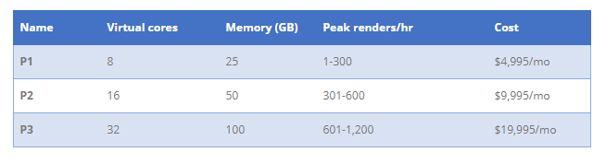
P SKUs (P is for Premium)
All-in version which allows greatest flexibility
Used to provide free users with access to apps and content
Used to support 1st party and 3rd party embedding
The more you pay per month, the more resources you get

Slide 16
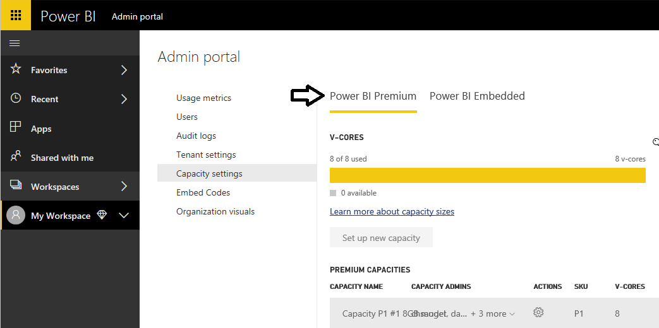
Managing Power BI Premium Capacities

Slide 17
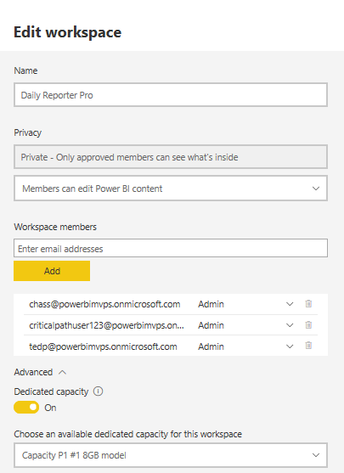
Associating Workspaces with Capacities

Slide 18
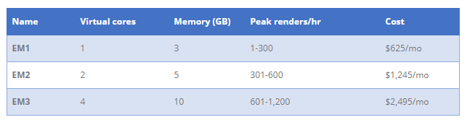
EM SKUs (EM is for Embedded)
SKUs for embedding into SaaS Applications
SaaS applications include SharePoint and Teams
Supports 1st party and 3rd party embedding
Does not provide user with access to PowerBI.com

Slide 19
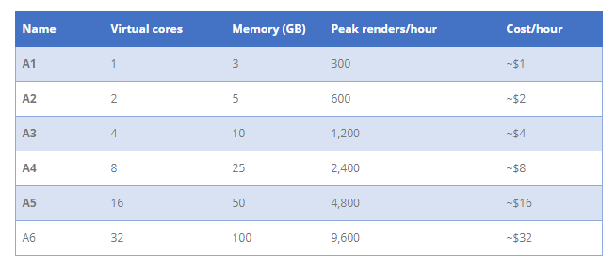
A SKUs (A is for Azure)
A SKU is a Platform-as-a-Service
Used by ISVs as the data visualization layer
Allows for PBI Embedding into Custom Applications
Only supports 3rd party embedding (i.e. App-Owns-Data model)

Slide 20
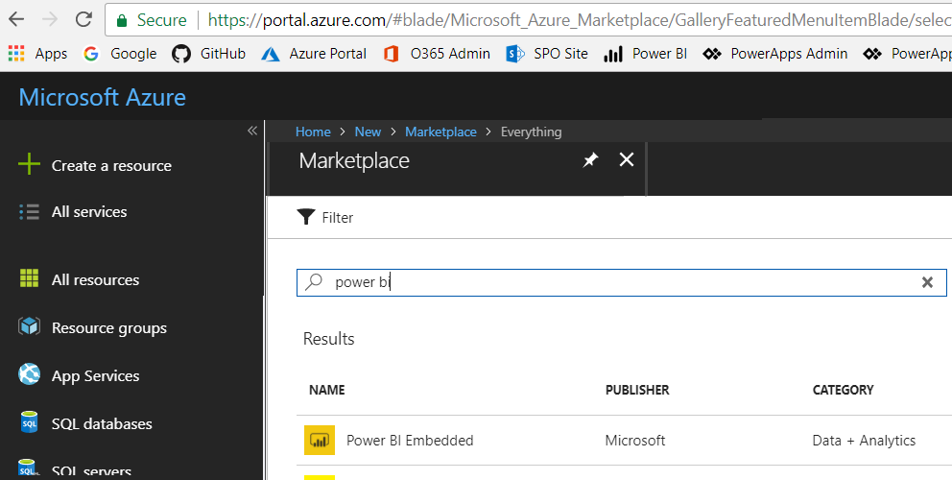
Creating the Power BI Embedded Service
Power BI Embedded in an Azure on-demand service
Can be created manually through the Azure portal
Can be created in automated fashion using PowerShell
Requires an Azure subscription

Slide 21
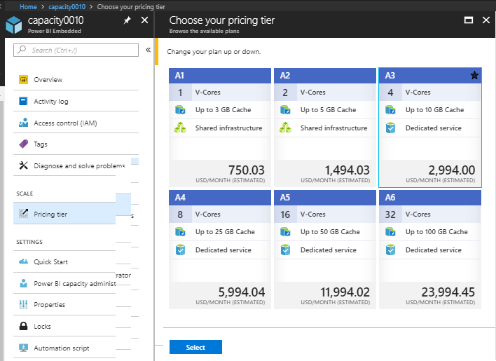
Azure Capacity Pricing Tiers

Slide 22
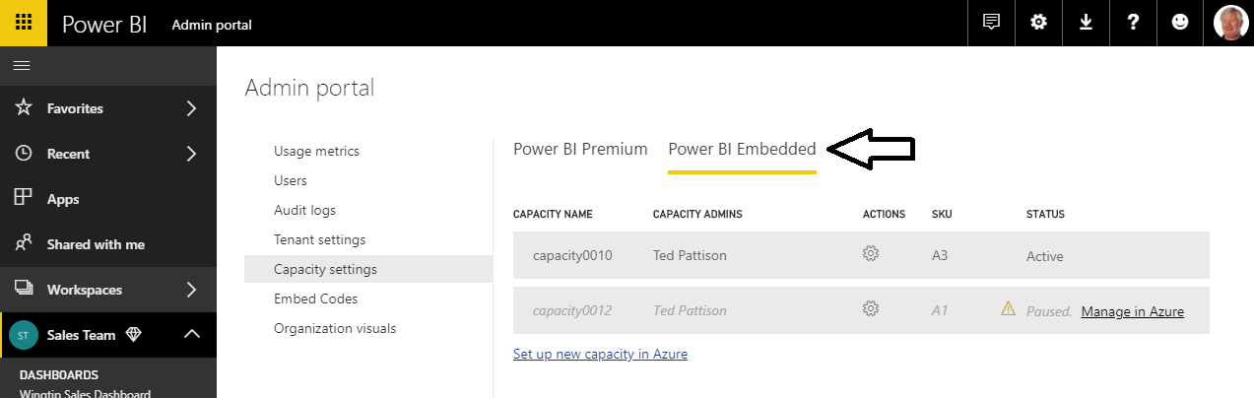
Managing Power BI Embedded Capacities

Slide 23
PBI Capacity SKU Decoder Ring
 | P SKU | EM SKU | A SKU
Purchased through… | Office 365 | Office 365 | Azure
Embed content in custom application | Yes | Yes | Yes
Share content with free PBI users outside PowerBI.com | Yes | Yes | No
Share content with free PBI users inside PowerBI.com | Yes | No | No
Billing | Monthly | Monthly | Hourly
Commitment | Monthly | Monthly/Yearly | None
Turn it off when your not using it | No | No | Yes

Slide 24
Agenda
Power BI Embedding Fundamentals
App Workspaces and Dedicated Capacities
Authentication with Azure Active Directory
Programming with Power BI Service API
Working with Embeddable Resources
Embedding with Power BI JavaScript API

Slide 25
Tenants and Organizational Accounts
Azure AD used to authenticate users and apps
PBI licenses are assigned to Azure AD user accounts
Organization owns a tenant (i.e. directory)
AAD tenant contains user accounts and groups
AAD tenant contains set of registered applications
You must register your application with Azure AD
Requirement of calling to Power BI service API
Applications registered as Web app or Native app
Registered applications are assigned GUID for client ID
Application is configured with permissions

Slide 26
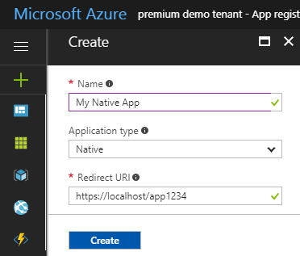
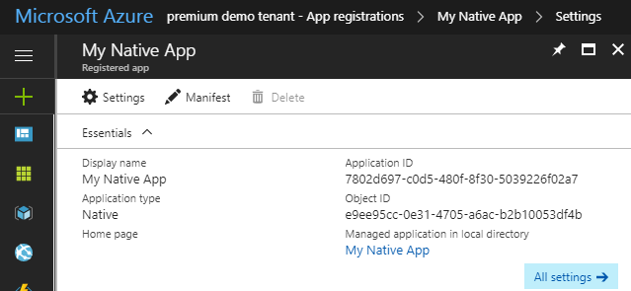
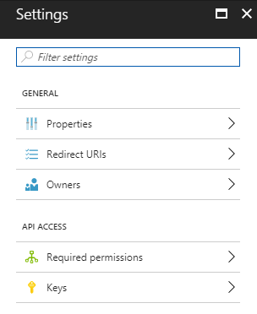
Creating an Azure AD Application

Slide 27
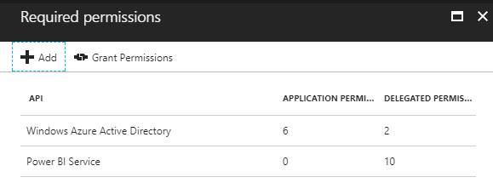
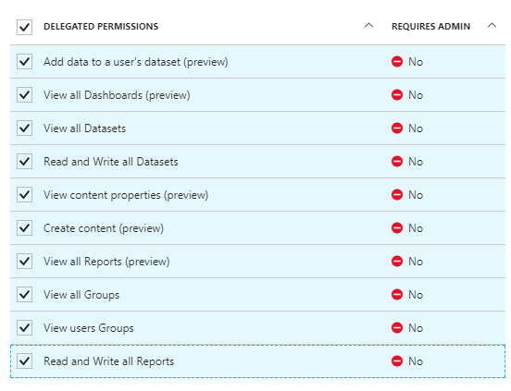
Application Permissions
Applications can be granted permissions to other applications
Application permissions are app-only permissions
Delegated permissions are (app + user) permissions
Delegated permissions requires 1-time consent from user

Slide 28
1st Party Embedding vs 3rd Party Embedding
 | 1st Part Embedding | 3rd Party Embedding
Authentication flow | Authentication Code Grant Flow or Implicit Flow | Direct User Credentials
Identity used to call Power BI | Current User | Master User Account
Access to personal workspace | Yes | No
Access to app workspaces | Yes | Yes
Ability to reach non-licensed users | No | Yes
Supported Power BI Capacity SKUs | P* and EM* SKUs | P*, EM* and A* SKUs

Slide 29
Registering an App with Azure AD

Slide 30
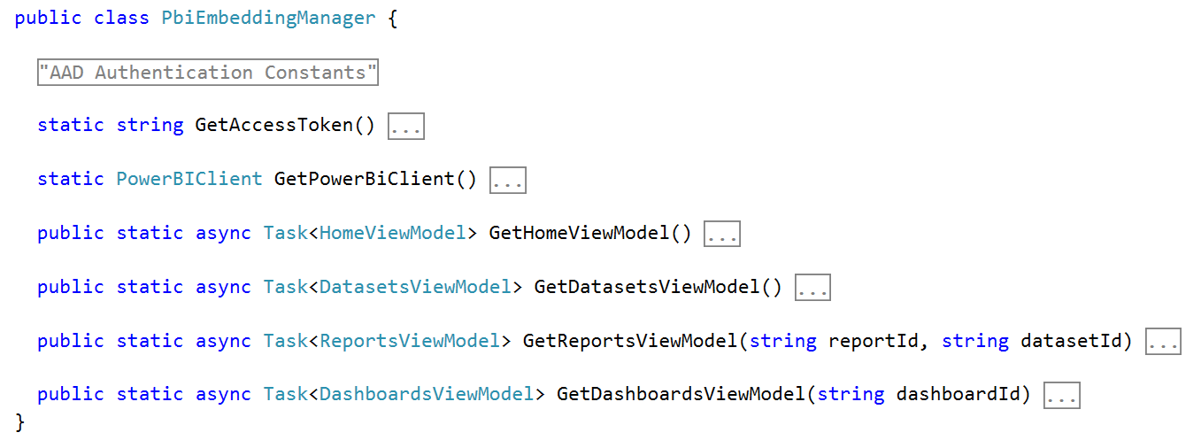
PbiEmbeddingManger Class
PbiEmbeddingManger Class responsibilities
Get access tokens from Azure AD
Retrieve embedding data from Power BI service
Pass embedding data to browser using MVC view models

Slide 31
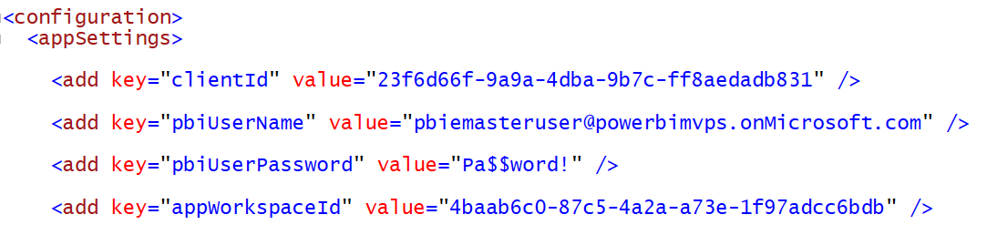
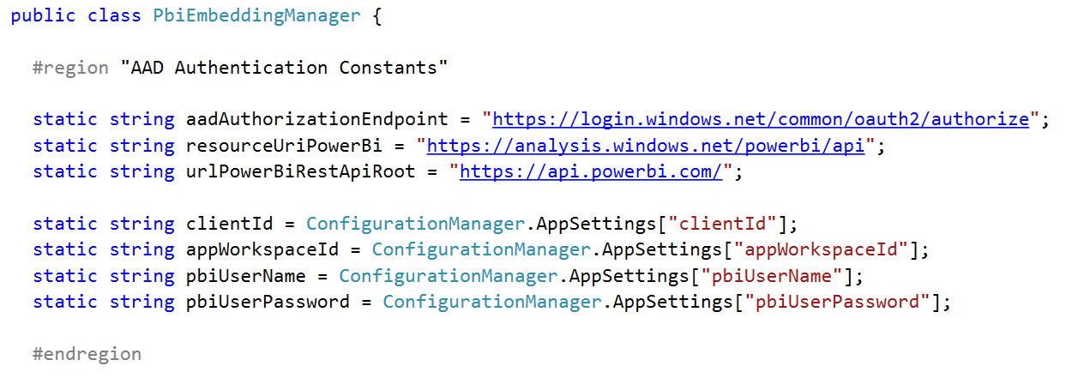
Data Required for AAD Authentication

Slide 32
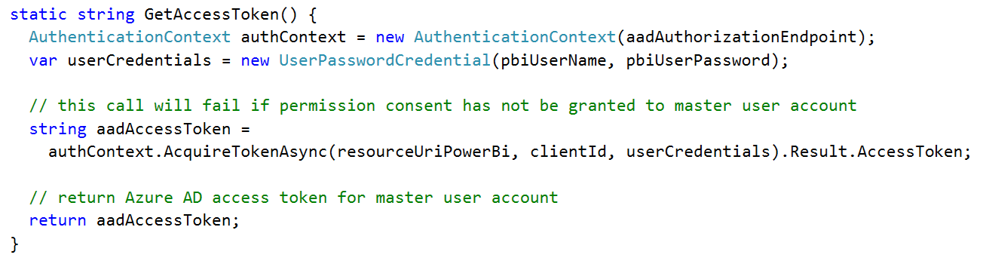
Getting an Access Token for the Master User

Slide 33
Agenda
Power BI Embedding Fundamentals
App Workspaces and Dedicated Capacities
Authentication with Azure Active Directory
Programming with Power BI Service API
Working with Embeddable Resources
Embedding with Power BI JavaScript API

Slide 34
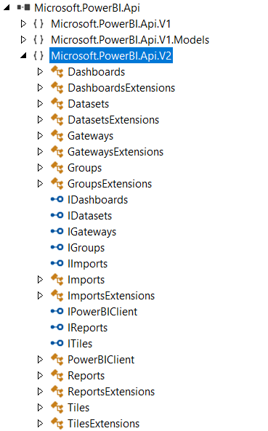
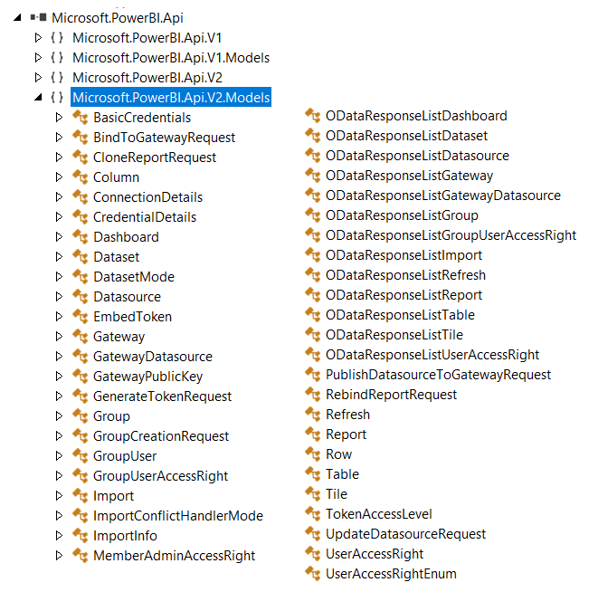
The Power BI Service API

Slide 35
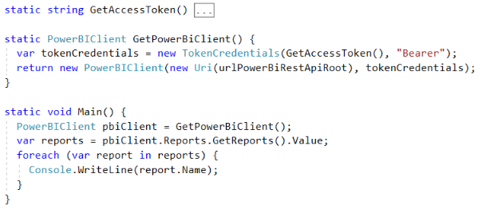
Initializing an Instance of PowerBIClient
PowerBIClient object serves as top-level object
Used to execute calls against Power BI Service
Initialized with function to retrieve AAD access token

Slide 36
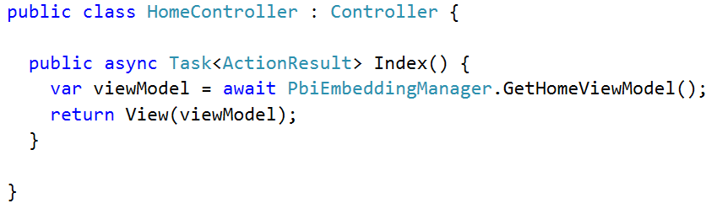
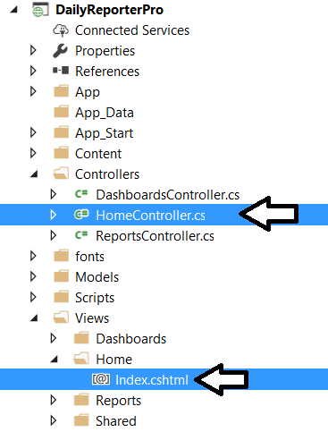
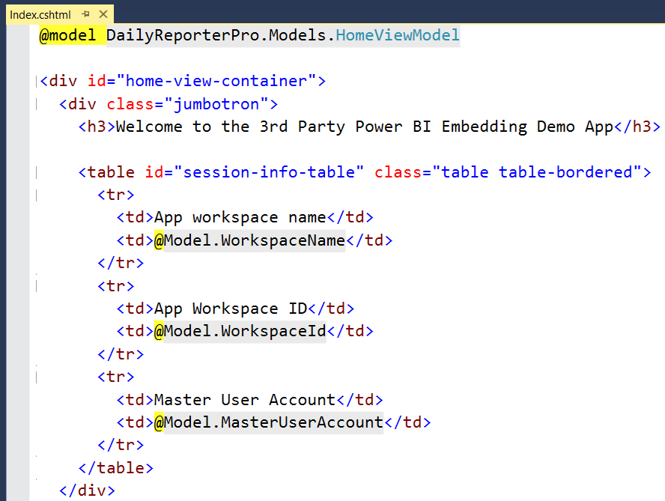
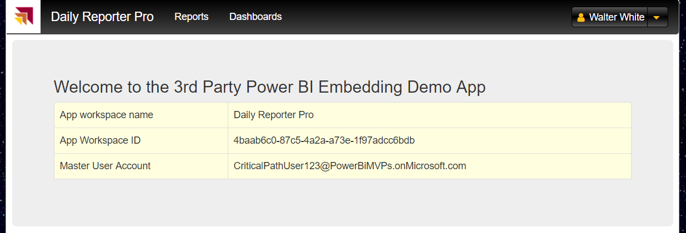
MVC Controllers and Views

Slide 37
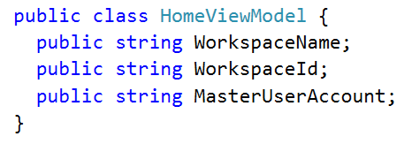
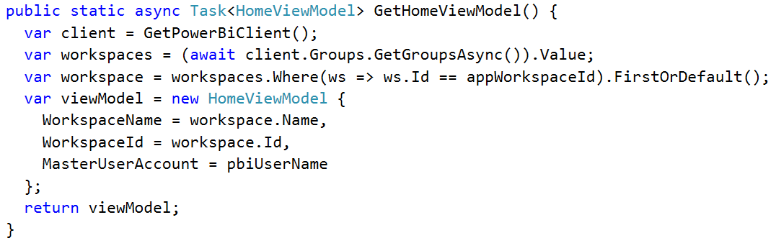
Back to the DailyReporterPro Application
Your App
Power BI Service

Slide 38
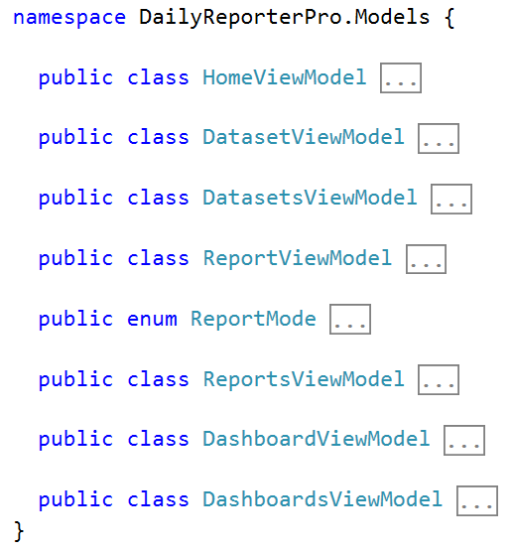
MVC View Models

Slide 39
Agenda
Power BI Embedding Fundamentals
App Workspaces and Dedicated Capacities
Authentication with Azure Active Directory
Programming with Power BI Service API
Working with Embeddable Resources
Embedding with Power BI JavaScript API

Slide 40
Embeddable Resources
Reports
Dashboards
Dashboard Tiles
Q & A Experience
Visual *
* really just a trick you do when embedding a report

Slide 41
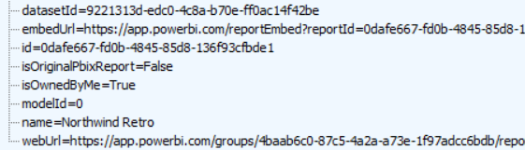

Report and Dataset Info
Embed data required for an existing report
Embed data for dataset required to create new report

Slide 42
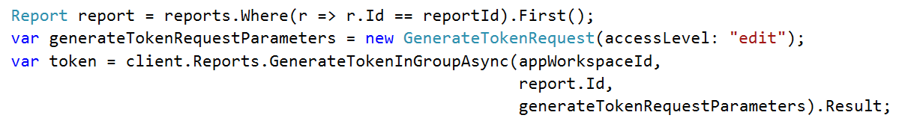
Embed Tokens
You can embed reports using master user AAD token, but…
You might want embed resource using more restricted tokens
You might want stay within the bounds of Power BI licensing terms
Power BI service supports generating embed tokens
Embed token provides restrictions on whether user can view or edit
Each embed token created for one specific resource
Embed token can only be generated inside Power BI Premium capacity
Supports generating tokens using row-level security (RLS)

Slide 43
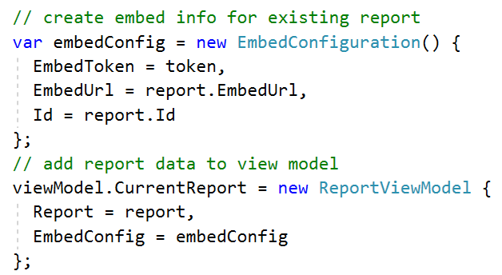
View Model with Embed Data for Report

Slide 44
Agenda
Power BI Embedding Fundamentals
App Workspaces and Dedicated Capacities
Authentication with Azure Active Directory
Programming with Power BI Service API
Working with Embeddable Resources
Embedding with Power BI JavaScript API

Slide 45
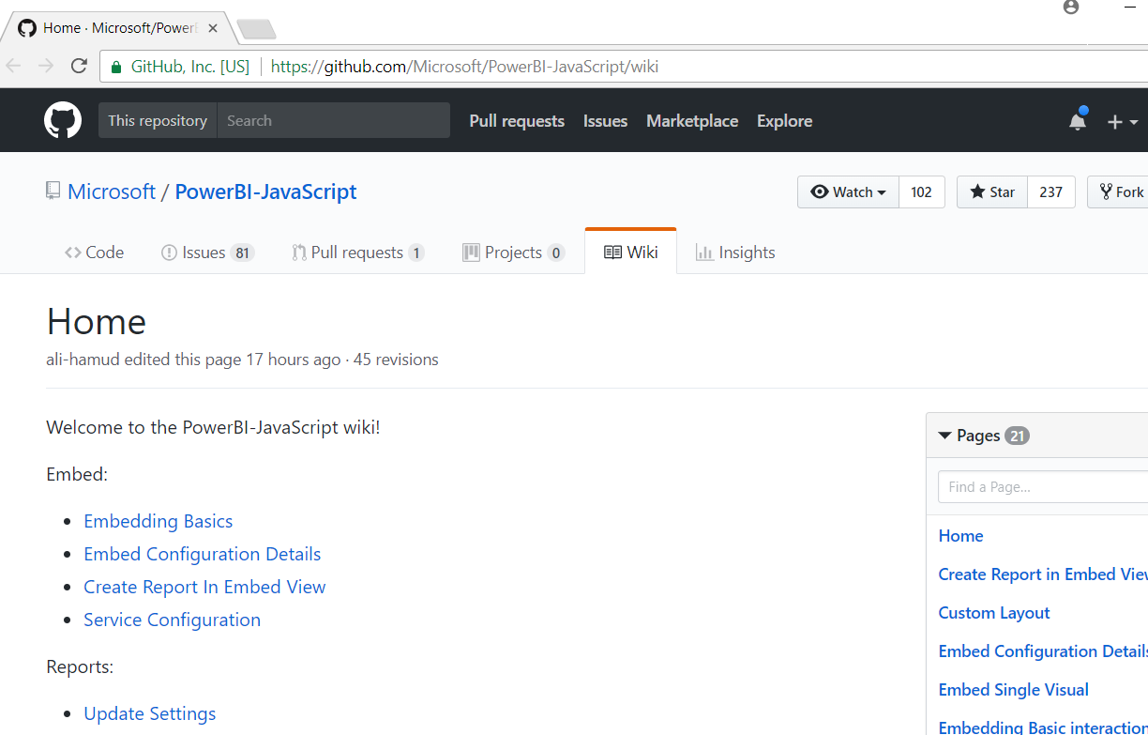
Power BI JavaScript API (PBIJS)
https://github.com/Microsoft/PowerBI-JavaScript/wiki

Slide 46
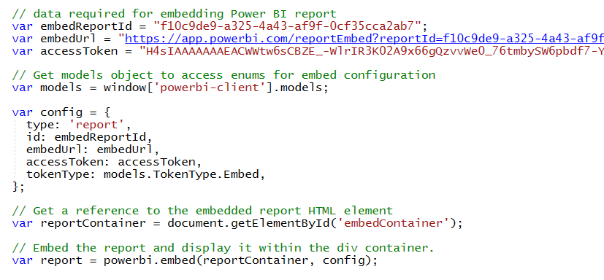
Hello World with Power BI Embedding
PBIJS library provides powerbi as top-level service object
You create configuration and then call powerbi.embed to embed a report
You must pass access token as part of the configuration

Slide 47
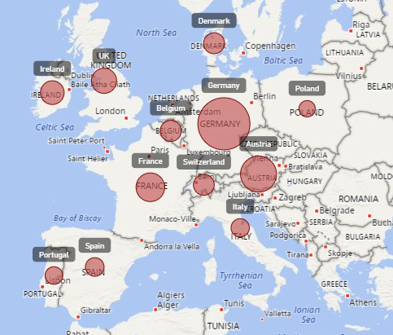
Report Embedding Architecture
Embedding involves creating an iFrame on the page
PBIJS transparently creates iFrame and sets source to Power BI Service
The iFrame and hosting page originate from different DNS domains
Your HTML and CSS
https://app1.mydomain.com
Web Hosting Server
Your
JavaScript
iFrame
Embedding Data
https://wabi-us-east2-redirect.analysis.windows.net/
powerbi.js
Power BI Service

Slide 48
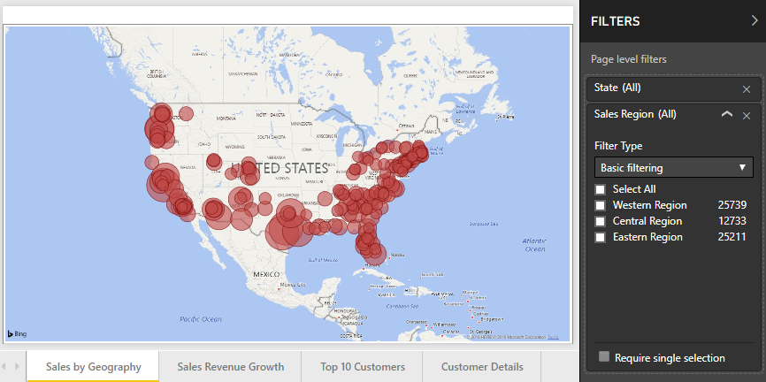
Post Message Communications Flow
4 extra libraries used communicate with report in iFrame
window-post-message-proxy (WPMP)
http-post-message (HPM)
powerbi-router (PBIR)
powerbi-models (PBIM)
iFrame
Your
JavaScript
service
report
HPM
PBIR
WPMP
WPMP
PBIR
HPM

Slide 49
A Promise-based Programming Model
Design of PBIJS simulates HTTP protocol
Creates more intuitive programming model for developers
Programming based on asynchronous requests and promises
Embedded objects programmed using actions and events
Actions
report.fullscreen
report
report.switchMode
report.setFilters
Your
JavaScript
report.getPages
Events
report.loaded
report.pageChanged
report.commandTriggered

Slide 50
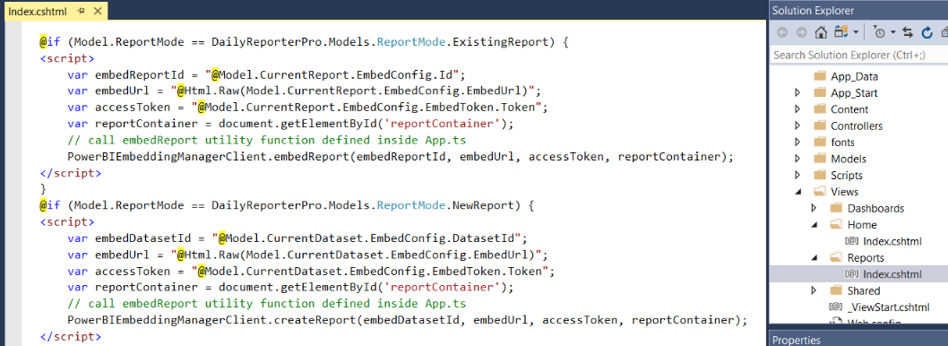
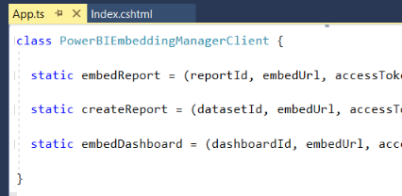
Embedding Data in MVC View

Slide 51
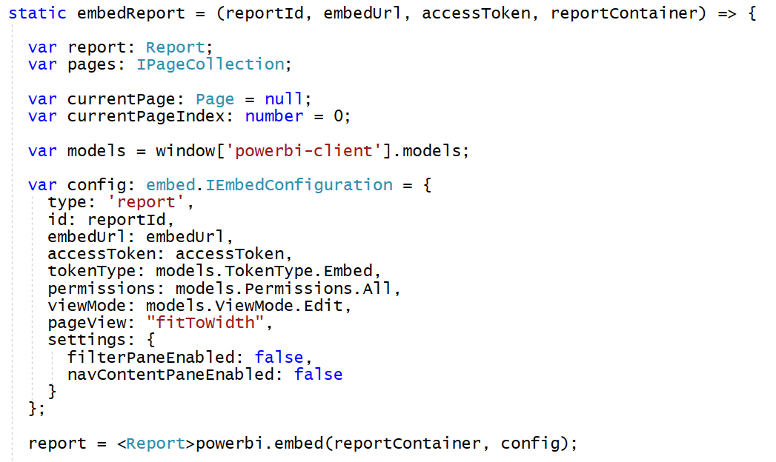
Loading an Embedded Report

Slide 52
Embedded Report Options
Read: Allows view report only.
ReadWrite: Allows view, Edit and Save report.
Copy: Allows Save a copy of a report using Save As.
Create: Allows creating a new report.
All: Allows everything.
View - Opens report in View mode.
Edit - Opens report in Edit mode.
fitToWidth: Fit to width of host HTML element.
oneColumn: Opens in single column.
actualSize: Actual size as designed in report

Slide 53
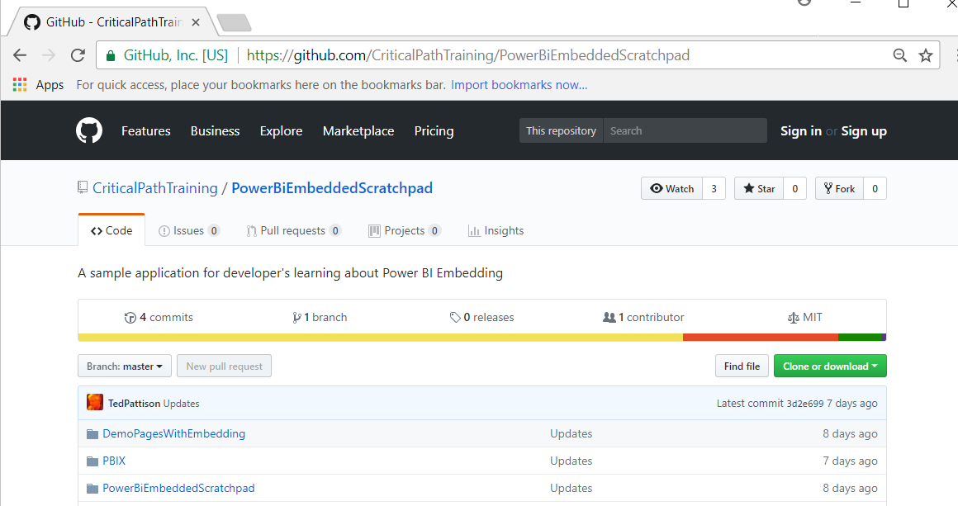
PowerBiEmbeddedScratchpad Sample
https://github.com/CriticalPathTraining/PowerBiEmbeddedScratchpad

Slide 54
The Power BI Embedded Scratchpad App

Slide 55
Summary
Power BI Embedding Fundamentals
App Workspaces and Dedicated Capacities
Authentication with Azure Active Directory
Programming with Power BI Service API
Working with Embeddable Resources
Embedding with Power BI JavaScript API

Slide 56

Critical Path Training https://www.CriticalPathTrainig.com
PBI365: Power BI Boot Camp – 4 Days
Audience is Business Users, Analysts and Data Professionals
Provides hands-on introduction to the Power BI platform
Focuses on build solutions using Power BI Desktop
Query design, data modeling and report and dashboard design
Apps and App Workspaces
Learn about “import” vs “connect to” with Excel workbooks
PBD365: Power BI Developer Boot Camp – 4 Days
Audience is Professional Developers
Teaches developing custom visuals with TypeScript and D3
Teaches R programming and integrating R with Power BI
Teaches programming with the Power BI APIs
Teaches developing with Power BI Embedded

